Slide 1


DEPARTMENT OF COMPUTER SCIENCE AND ENGINEERING
GE19612 – PROFESSIONAL READINESS FOR INNOVATION,
EMPLOYABILITY AND ENTREPRENEURSHIP
GAMIFIED LEARNING PLATFORM
FOR DISABLED STUDENTS
MENTOR : Dr. K. Ananthajothi
Team Member 1 : Manthraa A (2116210701151)
Team Member 2 : Mitesh A (2116210701158)
Team Member 3 : Pradeep S (2116210701189)

Slide 2
ABSTRACT
Edzen is a groundbreaking educational platform committed to revolutionizing the way students engage with learning. Rooted in the belief that education should be a holistic journey towards personal and intellectual growth, Edzen seamlessly integrates state-of-the-art technology with pedagogical expertise to offer an unparalleled learning experience. Our platform boasts a diverse array of interactive courses spanning STEM disciplines, humanities, arts, and beyond, ensuring that learners of all interests and backgrounds can find their passion and unlock their full potential. Central to the Edzen experience is the incorporation of mindfulness practices into the learning process, fostering focus, resilience, and emotional intelligence. Through adaptive learning algorithms, personalized recommendations, and real-time feedback, Edzen empowers students to progress at their own pace, catering to individual learning styles and preferences. Moreover, our community-driven approach encourages collaboration, peer learning, and knowledge sharing, creating a vibrant ecosystem where every learner's voice is valued. Edzen isn't just a platform; it's a catalyst for educational transformation, aiming to redefine the boundaries of learning and inspire a generation of lifelong learners who are equipped to thrive in an ever-evolving world. Join us on this journey to unleash the full potential of education and discover the zenith of learning with Edzen.

Slide 3
PROBLEM STATEMENT
In the rapidly advancing digital era, the demand for coding skills is burgeoning, yet access to quality coding education remains inequitable due to outdated curricula, high costs, and standardized approaches that fail to cater to diverse learning needs. This lack of accessibility and inclusivity perpetuates feelings of disengagement and inadequacy among learners, exacerbating the prevalence of imposter syndrome. Consequently, there is an urgent need for innovative solutions like Edzen, which aims to democratize coding education, provide personalized learning experiences, and cultivate a supportive community, empowering learners to overcome barriers and succeed in the digital age.

Slide 4
METHODOLODGY
The methodology for developing Edzen's online educational platform involves several key steps. Firstly, a comprehensive needs assessment will be conducted to understand the learning requirements, preferences, and challenges of the target audience. This will involve gathering insights through surveys, interviews, and market research. Based on the findings, a curriculum framework will be designed in collaboration with subject matter experts, defining learning objectives and selecting appropriate coding languages and technologies.
Next, an intuitive online platform will be developed, incorporating interactive learning modules, coding exercises, and project-based assessments. User-centered design principles will guide the creation of a user-friendly interface optimized for various devices and platforms. High-quality instructional materials, including video lectures, tutorials, and coding challenges, will be produced to align with the curriculum framework and engage learners effectively
Experienced instructors will be recruited and trained to facilitate learning and provide guidance and feedback to learners. Ongoing technical support will ensure a seamless learning experience, with mechanisms in place for troubleshooting and addressing user inquiries promptly
Community engagement will be fostered through the establishment of a supportive online community, enabling learners to collaborate, share knowledge, and seek assistance from peers and instructors. Regular usability testing and user surveys will inform iterative development, continuously refining the platform and content based on user feedback and emerging trends.

Slide 5
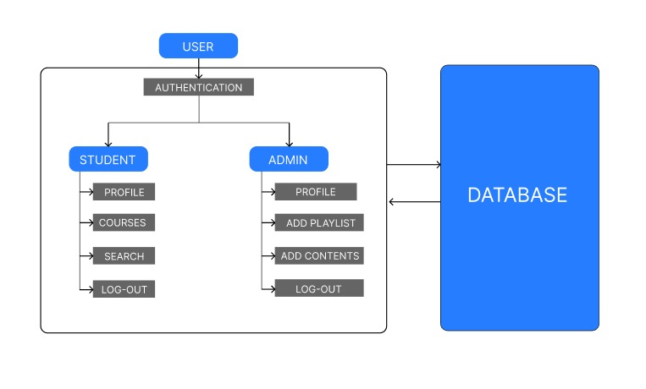
SYSTEM ARCHITECTURE DIAGRAM

Slide 6
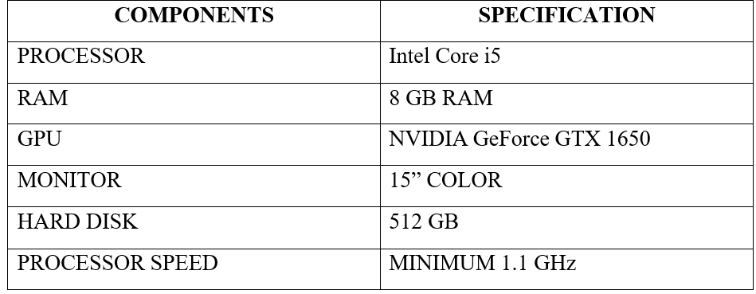
DEVELOPMENTAL ENVIRONMENT
Hardware Requirements
Software Requirements
Visual studio code and chrome would all be required.

Slide 7
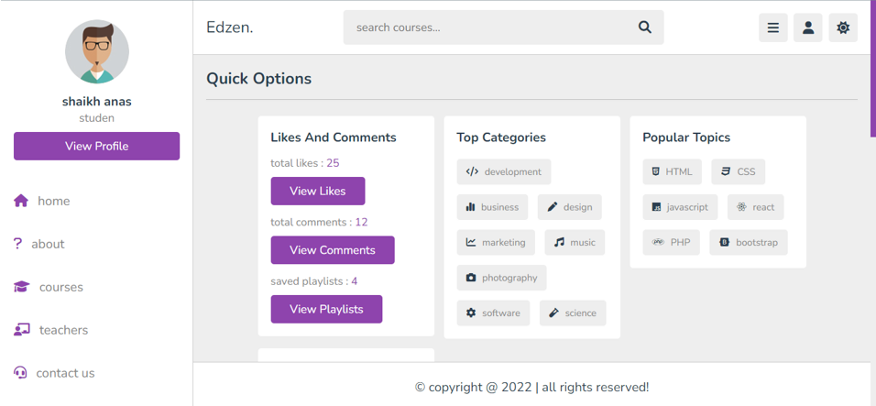
IMPLEMENTATION
Fig 1: Home Page

Slide 8
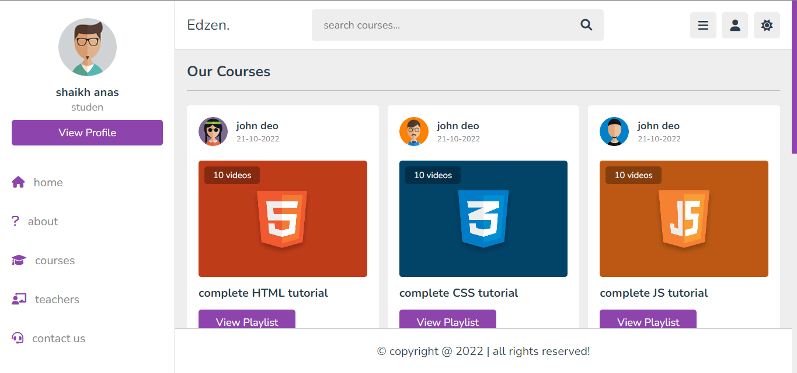
IMPLEMENTATION
Fig 2: Courses Page

Slide 9
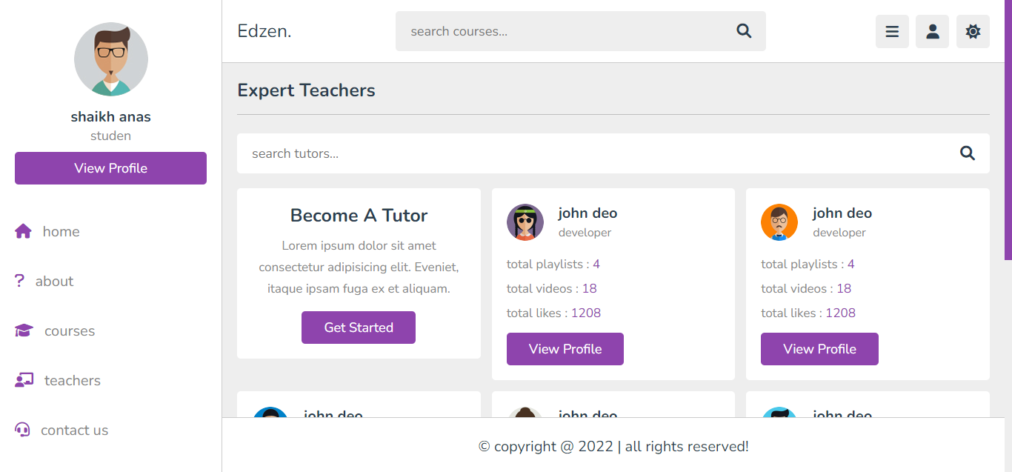
IMPLEMENTATION
Fig 3: Teacher Page

Slide 10
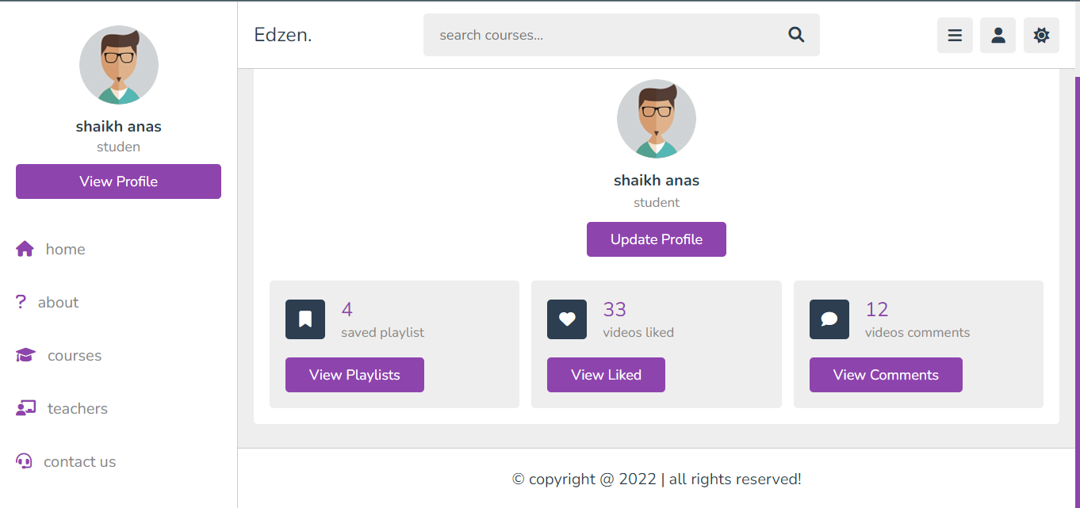
IMPLEMENTATION
Fig 4: Profile Page

Slide 11
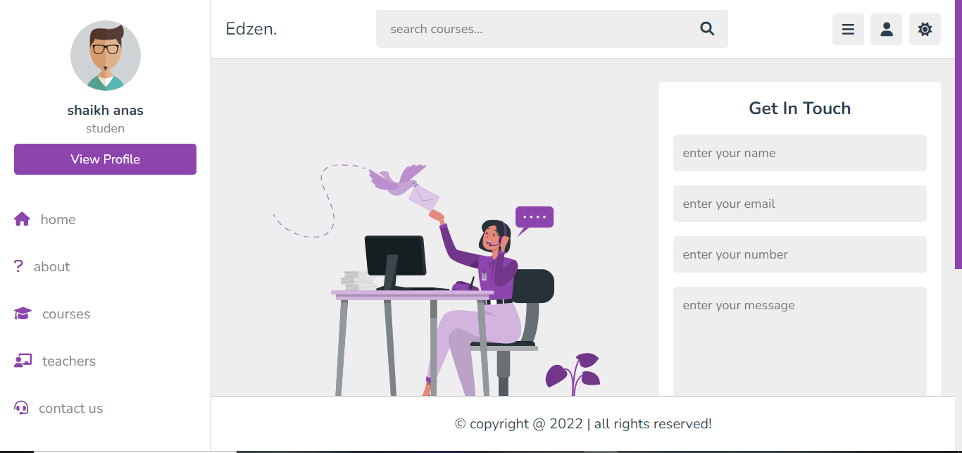
IMPLEMENTATION
Fig 5: Contact Page

Slide 12
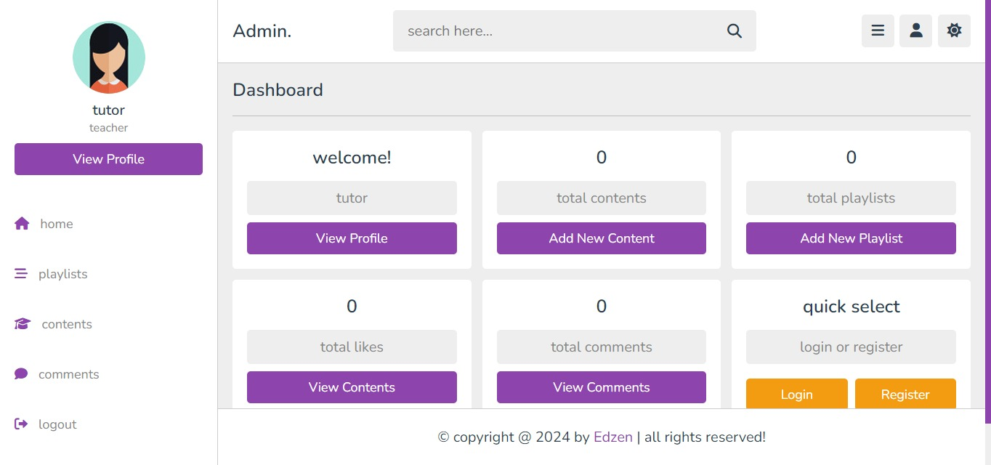
IMPLEMENTATION
Fig 5: Teacher Profile

Slide 13
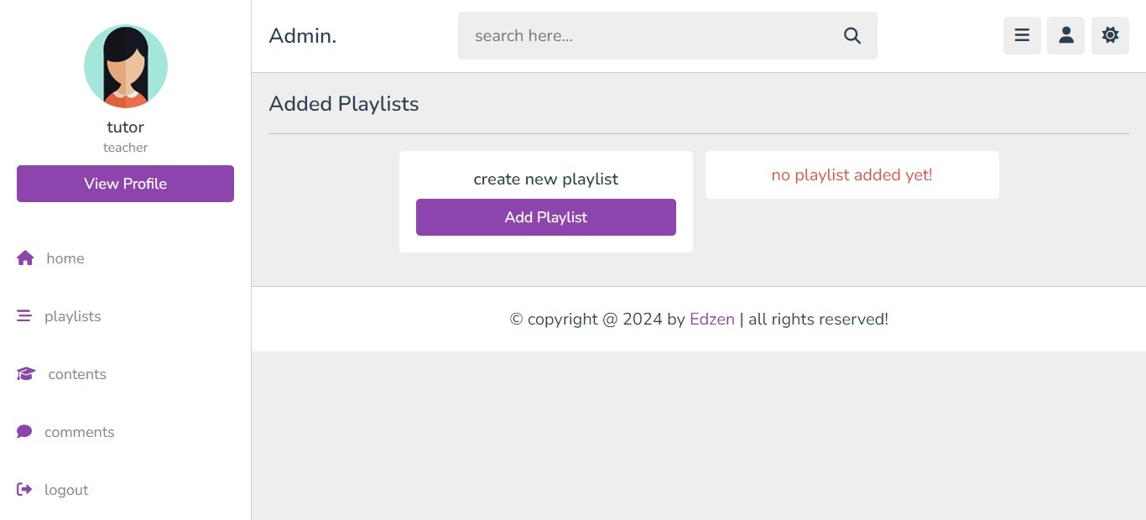
IMPLEMENTATION
Fig 5: Add Playlist Page

Slide 14
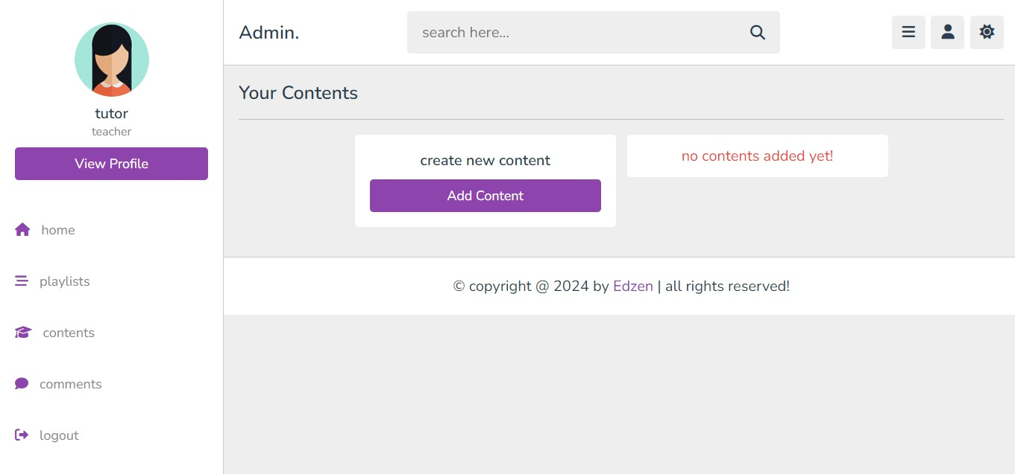
IMPLEMENTATION
Fig 5: Add Content Page

Slide 15
IMPLEMENTATION
Fig 5: Add Playlist Page

Slide 16
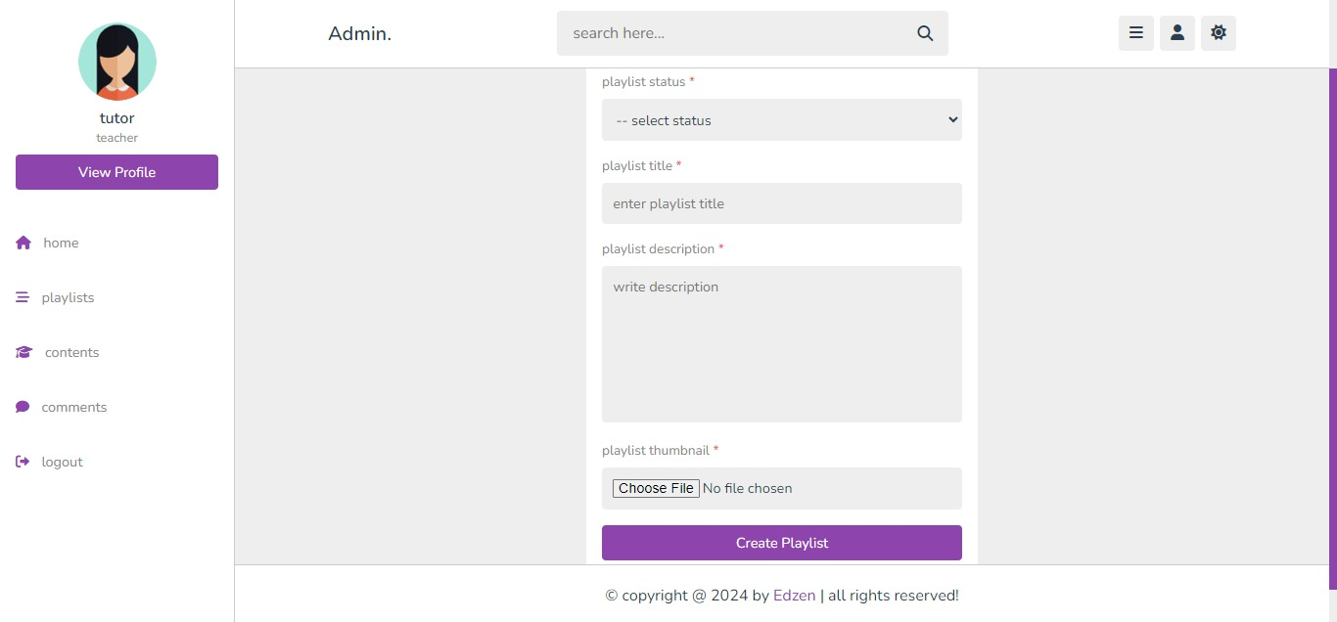
IMPLEMENTATION
Fig 5: Create Playlist Page

Slide 17
REFERENCES
[1] Smith, J., et al. (2020). "Democratizing Education through Online Learning Platforms." Journal of Educational Technology, 45(2), 123-137.
[2] Brown, L., et al. (2019). "Effective Online Learning Strategies: A Comprehensive Review." International Journal of Educational Technology, 32(4), 289-305.
[3] Johnson, K., et al. (2021). "The Importance of Inclusivity in Online Education." Diversity in Education Journal, 18(3), 201-215.
[4] Lee, M., et al. (2018). "Mindfulness in Education: A Review of Current Research." Educational Psychology Review, 26(3), 357-375.
[5] Patel, S., et al. (2020). "Emerging Trends in Coding Education." Computer Science Education Journal, 38(1), 45-61.
[6] Garcia, R., et al. (2019). "The Impact of Online Learning Platforms on Educational Equity." Journal of Distance Education, 22(3), 189-204.

